Slide 1
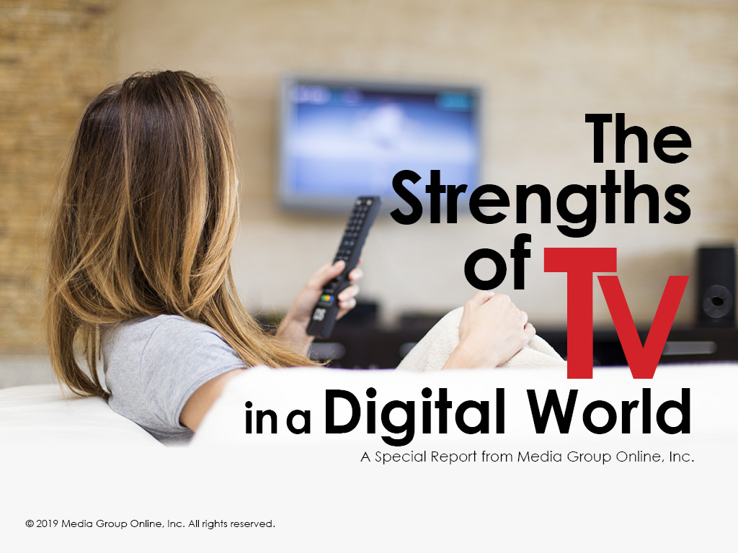

Slide 2
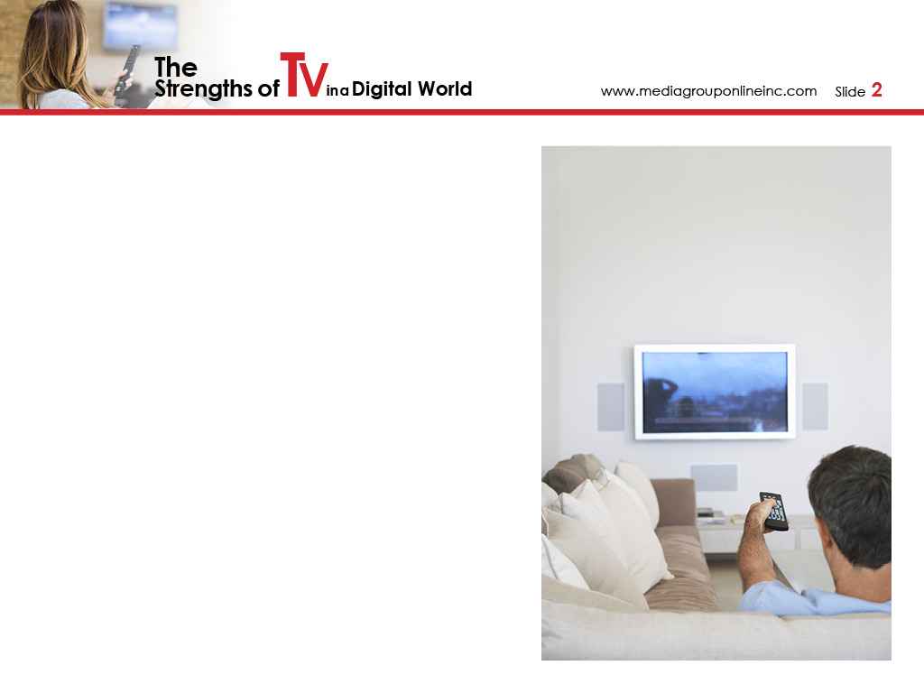
The Emotional Medium
With TV, more of the senses are needed to connect with the content and it is the overwhelming experience and effect of how the audience uses TV that also makes it the most emotional medium.
Emotions drive the decision to buy a product or service, which is the beginning of the purchase funnel, and TV is the best ad medium to make the initial emotional connection with consumers who want to fulfill a need.
TV’s emotional connection with its audience is directly related to its strength as an advertising medium – and it must be an important (and maybe the most important) component of your prospects and clients’ advertising spending.

Slide 3
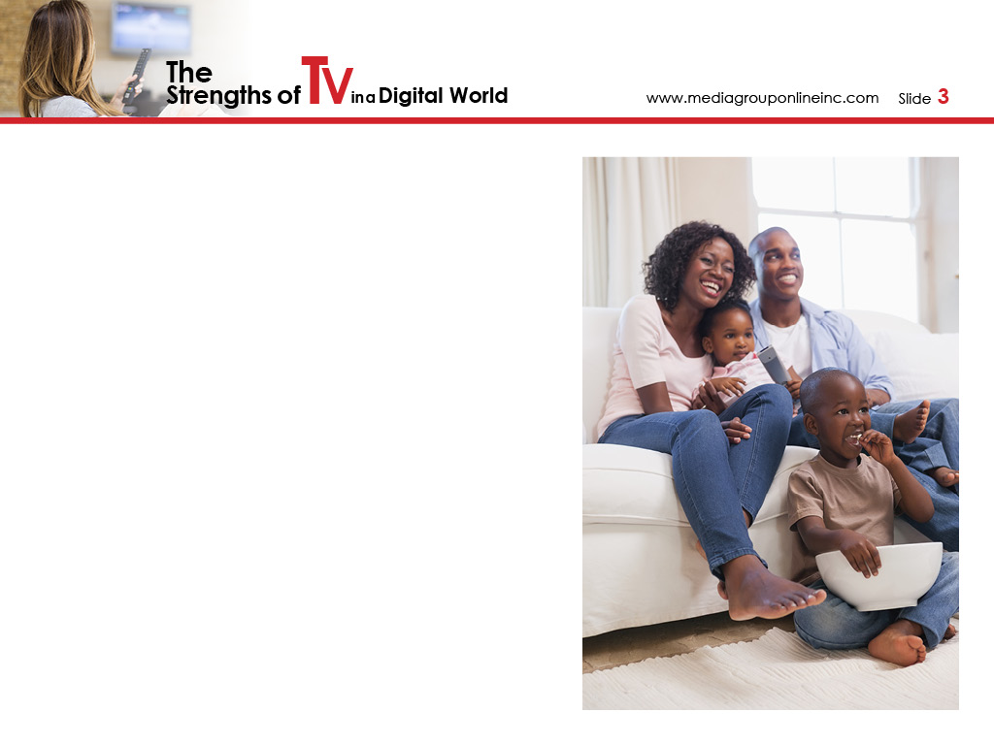
The Research That Supports TV’s Emotional Strength
According to a 2016 Nielsen report, the application of advanced neuroscience techniques found “ads with the best emotional response generated a 23% lift in sales volume.”
2018 research from Dr. Karen Nelson-Field revealed that during an average second of advertising, TV viewers were twice as attentive to what they were watching than YouTube and 15 times more than Facebook.
According to Group M’s October 2018 report, The State of Video, “fewer than 20% of Facebook videos sustain viewing for three seconds” and “…a fully-viewed ad does a better job of improving brand recall, perception and purchase intent…”

Slide 4

The Nuances of Why Young Adults Watch Less Linear TV
Younger adults are more active and less sedentary than older adults, so it’s logical younger adults would choose to use a mobile device to access video content from many sources.
46% of 18–24 TV viewers say they are TV fans and 54% watch their favorite TV show every week, and 76% consider watching TV as a social experience.
Teens’ TV viewership hasn’t changed much during the 2017–2019 period, or 22.8 million, 22.5 million and 22.3 million, respectively.

Slide 5
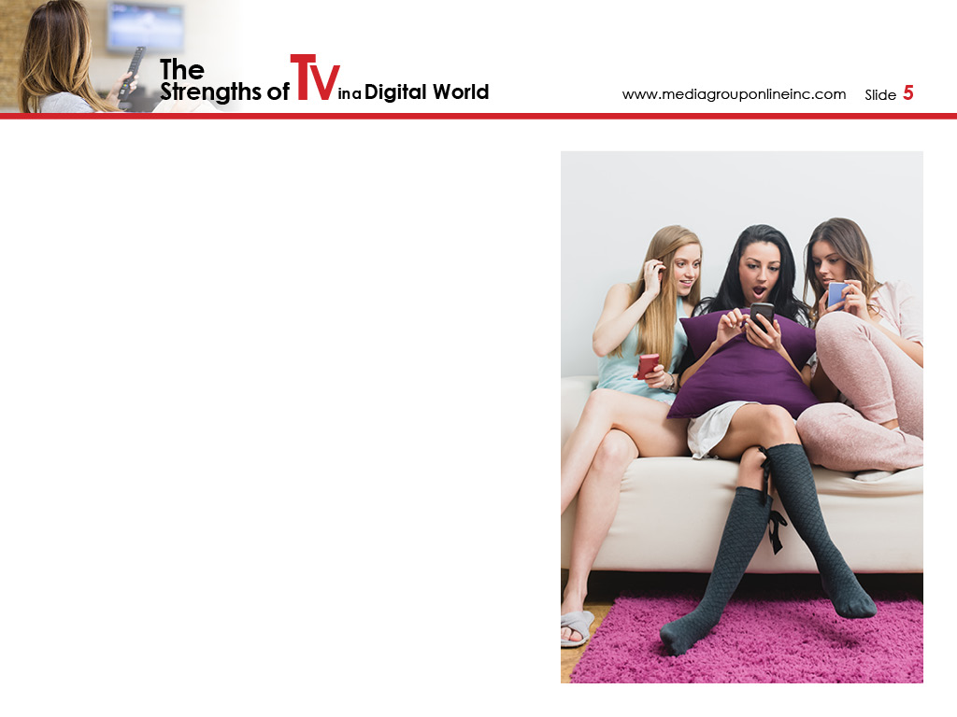
TV Has the Strength to Attract More Young Adults
Broadcasters must quickly transition from broadcasters to the local masters of digital and social media platforms and use all the digital channels – email, chat, messaging, videos and social media – to strengthen the connection.
Aggressively promote the station’s app (or create one if it doesn’t already exist) as the primary local source for entertainment content and local news.
Improve the relevance of local news broadcasts for young adults.

Slide 6
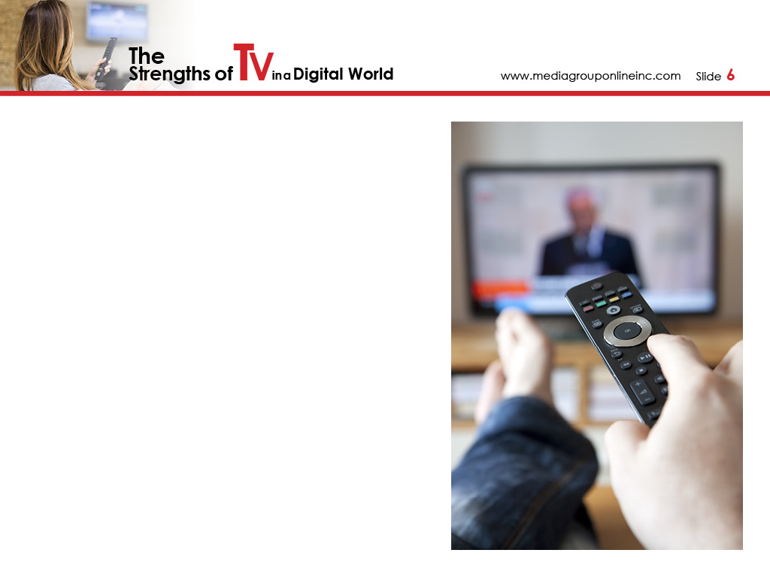
TV Is the News Channel
The latest survey (July 30–August 12, 2018) from Pew Research Center only reinforces local TV news’ dominance, as more US adults said they prefer to watch (47%) than read (34%) or listen (19%) to the news.
TV is also their preferred news platform, at 44%, compared to online, 34%; radio, 14%; and print, 7%.
Not surprisingly, the Pew Research Center found adults 18–49 who prefer reading the news do so via online sources; however, a majority, or 61%, of those who prefer to watch the news prefer TV.

Slide 7
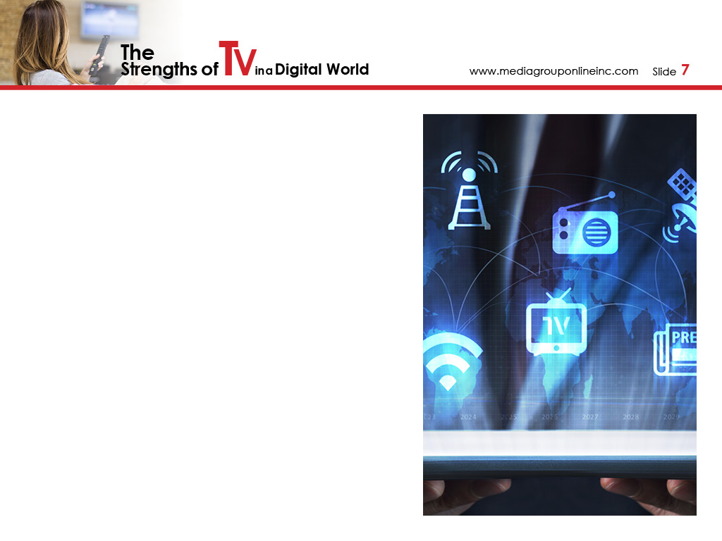
TV’s Cycle of Ad Spending Is the Norm
Local TV ad spending follows a regular cycle, with increased spending during years with major political campaigns, the Olympics, World Cup and other bi-annual events, and then less spending during years without these events.
BIA Advisory Services’ forecasts for local TV’s over-the-air revenues were a 5.8% increase during 2018, a 4.9% decrease for 2019, a 7.4% increase for 2020, a 4.7% decrease for 2021 and a 5.4% increase for 2022.
PwC’s forecast for the 2018–2022 period reveals total TV ad spending will increase 5.5%, to $74.9 billion, making it the overwhelming leader among local, traditional media.

Slide 8
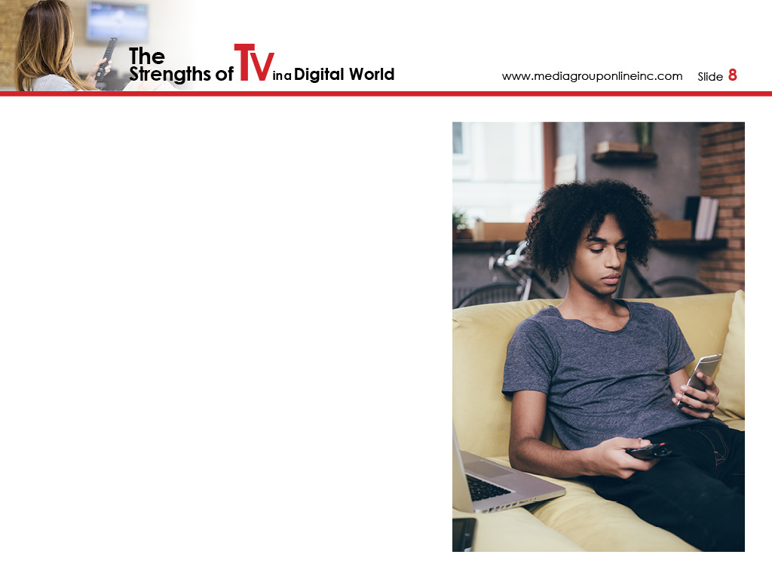
You and Your Clients’ Opportunities During This Cycle
During the 2018–2022 period, TV will generate an additional $5.7 billion in digital advertising, which reinforces what Media Group Online has reported for years: TV and digital advertising is the most complementary combination for local advertisers.
BIA Advisory Services reported during January 2019 that local, over-the-air TV advertising during 2019 will total more than $17 billion and digital/online $1.3 billion, an amount that will increase to $2.0 billion by 2023.
This is an exceptional opportunity for local TV advertising AEs to sell more social media, display advertising and video, adding billions to their over-the-air sales – and for local advertisers to reap the rewards.

Slide 9
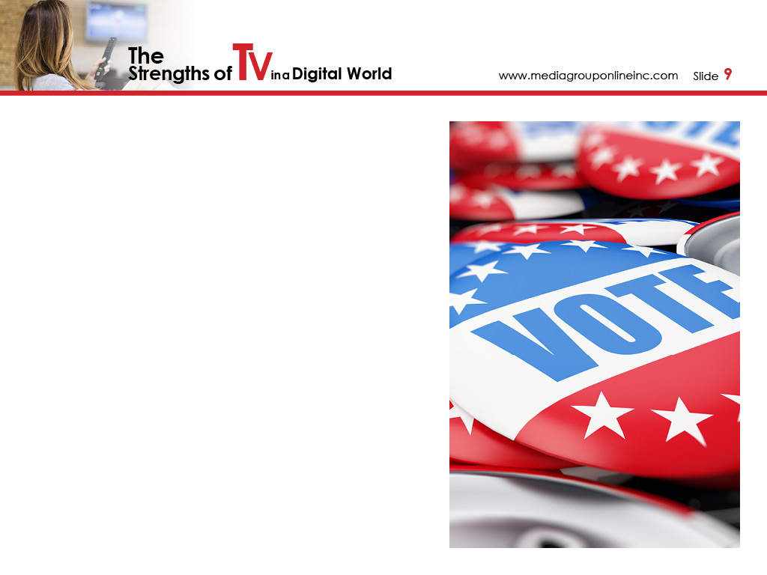
TV and the 2018 Midterm Elections
Local TV ad spending during the 2018 midterm elections totaled more than $3 billion, more than doubling the spending for the 2014 midterms, and which was 75% of all local, traditional media political spending.
Plus, those billions contributed significantly to eligible voter turnout of 50.3%, the largest since 1914.
In the first and fifth stages of the voter funnel, 55% of voters said TV was the #1 influencer for awareness and 45% said it influenced them to vote. All other media –mail, social media, radio and newspaper – were in single digits.

Slide 10
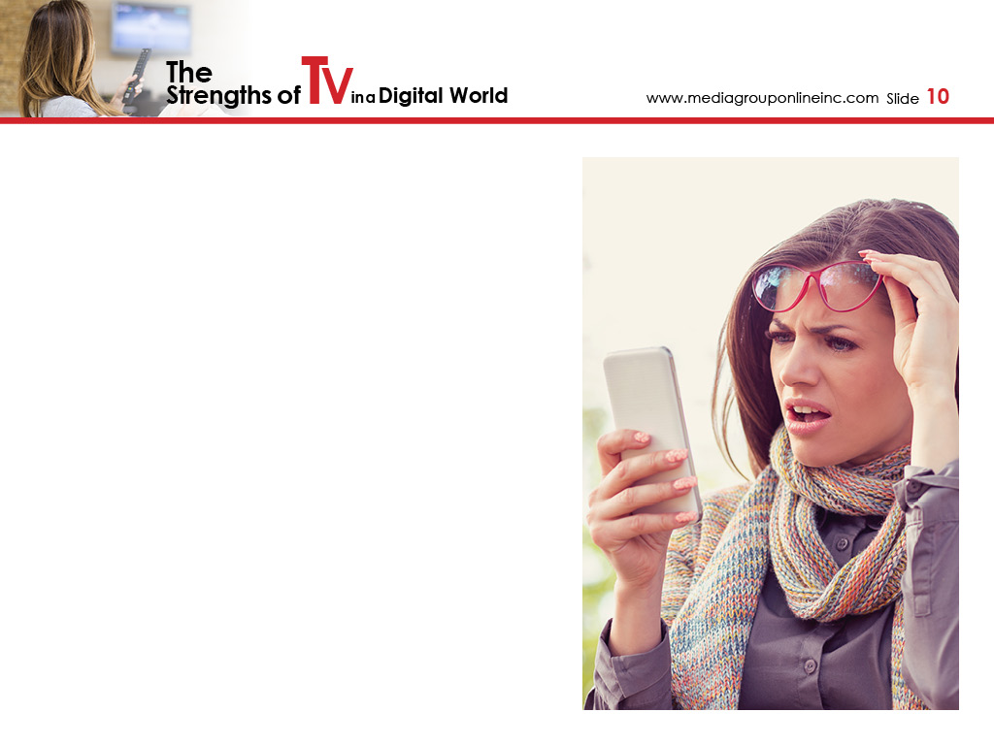
Voters Trust TV the Most
According to TVB’s Voter Funnel Study: Midterm Elections 2018, which surveyed more than 10,000 US adults, local broadcast news and the Website/apps of local TV news were the most trusted among voters.
When asked which media channels were the most prevalent for fake news, social media was first, at 59%; cable news second, at 37%; and all other Internet Websites/apps third, at 16%.
In comparison, only 6% said local broadcast news and only 4% said local TV news’ Websites/apps were prevalent sources of fake news.

Slide 11
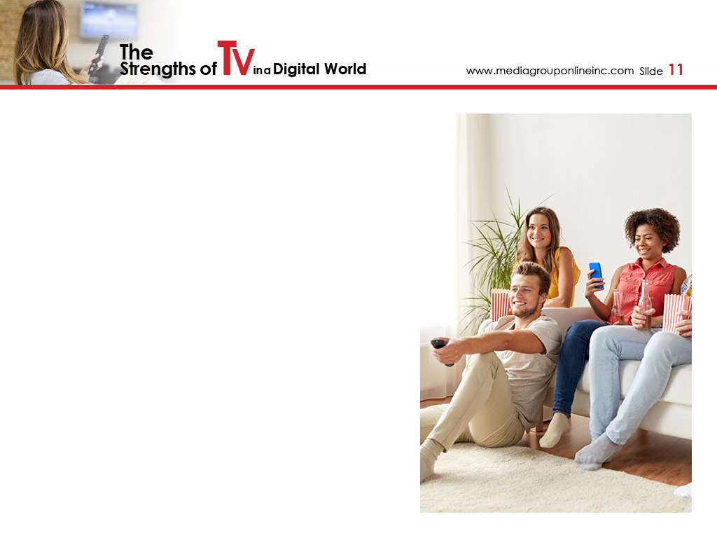
Watching TV Is a Sharing Experience
New research (November 2018) from GfK MRI reveals a truly remarkable strength that TV delivers better than any other medium – co-viewing, or watching TV with others to enhance the viewing experience.
The study reports 48% of TV time is spent co-viewing and almost half (49%) of all adults 18+ are watching TV with at least one other person more than they did during 2016.
Of even greater importance is the 60% of adults 18–34 who said their co-viewing has increased since 2016, although 72% said their co-viewing occurs while watching content from a streaming service.

Slide 12
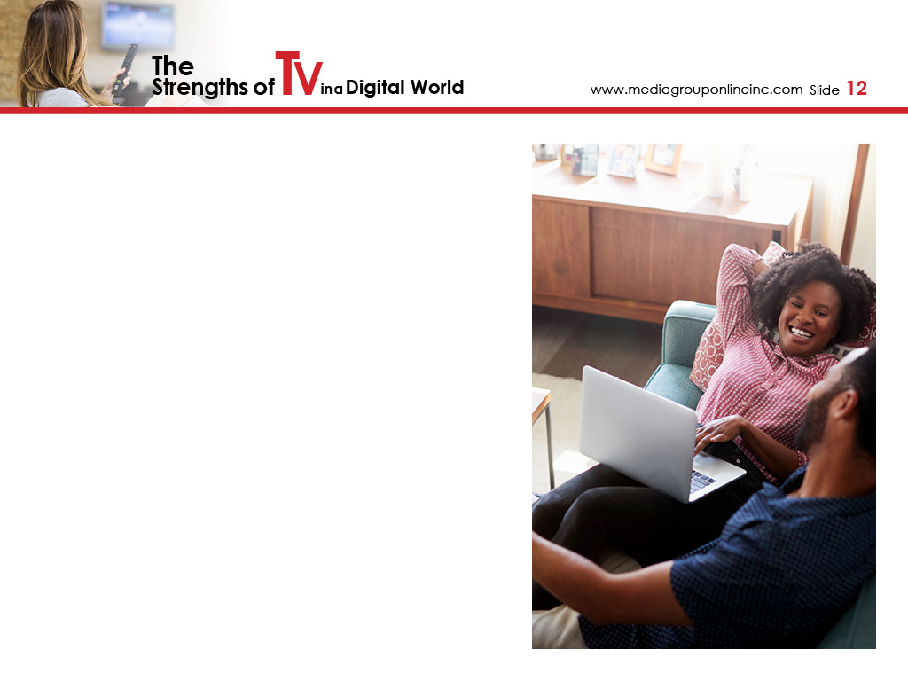
Consumer Actions Taken During Co-Viewing TV
According to a November 2017 MARU/Matchbox IAB study, 96% of surveyed adults said they were co-viewing on linear TV, compared to OTT, 93%; VOD, 90%; and DVR, 94%.
Co-viewing is a critical factor for advertisers, as 23% of consumers in the MARU/Matchbox IAB survey said they purchased a product/brand online they saw while watching linear TV.
Despite a majority of young adults co-viewing via a streaming service, it’s important to remind your clients that the largest OTT services don’t air commercials, so viewers aren’t seeing products/brands to consider for purchase.

Slide 13
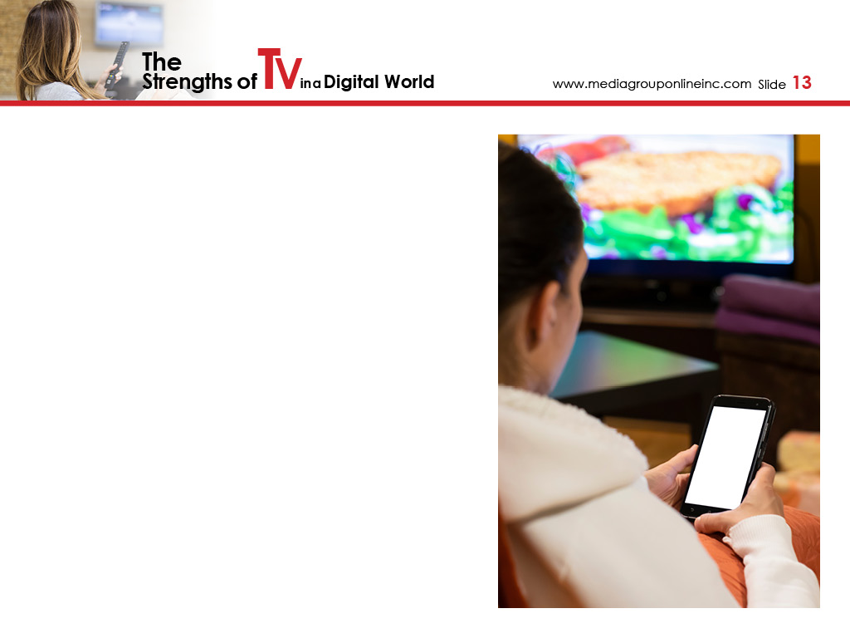
A Mobile Device Enhances the TV Viewing Experience
Another strength of TV that Media Group Online has stressed in many reports for a number of years is what has been called “second screening,” or simultaneously watching TV and using a mobile device.
A recent (November 2018) survey of 1,000 US adults from Aki Technologies, a mobile ad platform, found 59% of survey participants said “they pay attention to mobile ads while at home watching the big screen.”
Of particular interest is the study revealed 7% of Millennials said they are more likely to be interested in commercials, compared to Baby Boomers who were 6% less likely.

Slide 14
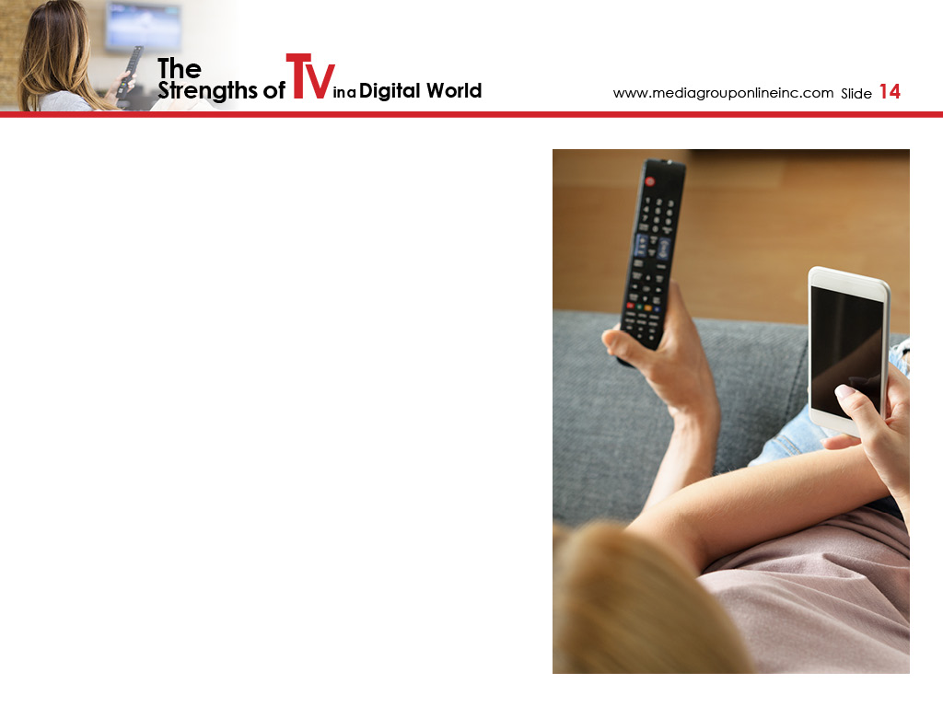
TV Commercials Drive Consumers to Their Mobile Devices
Another aspect of second-screening is one Media Group Online has championed for years – more TV commercials, including those of local retailers must drive viewers to retailers’ Websites and social media pages.
Accenture reports almost 90% of viewers are either holding a digital device or it’s in close proximity to where they are sitting and 67% of smartphone owners use their device to search for more information about commercials they’ve seen.
A report from WARC, a marketing information company, in which it studied two brands, determined 75% of incremental searches occurred within two minutes of the broadcast of TV spots, and specifically during live TV events.

Slide 15
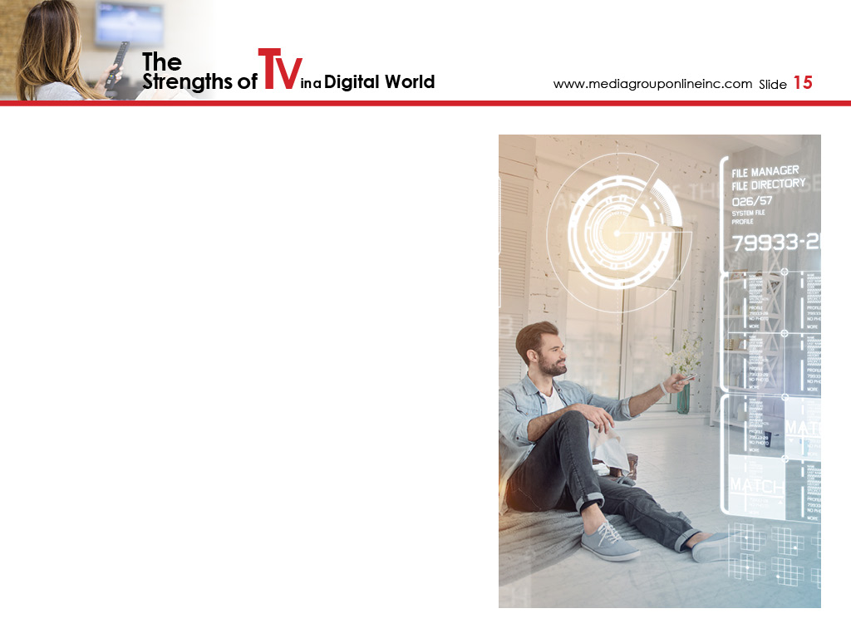
ATSC 3.0 Will Be TV on Steroids
The ATSC 3.0 standard will give OTA networks/stations the capability to deliver live events, especially sports, with much better picture quality. Currently, cable TV and OTT providers are unable to scale live events to the level of traditional TV.
ATSC 3.0 won’t become more common until 2020, at the soonest, as LG Electronics and Sony are just now testing the addition of an ATSC 3.0 chipset in TVs in Asia. TVs with this chipset won’t arrive in the US until 2020.
A January 2019 article in TVNewsCheck predicts that by approximately 2033, broadcasters could be generating as much revenues from data distribution as TV commercials, as the ATSC 3.0 standard will allow them to deliver 5G services.

Slide 16
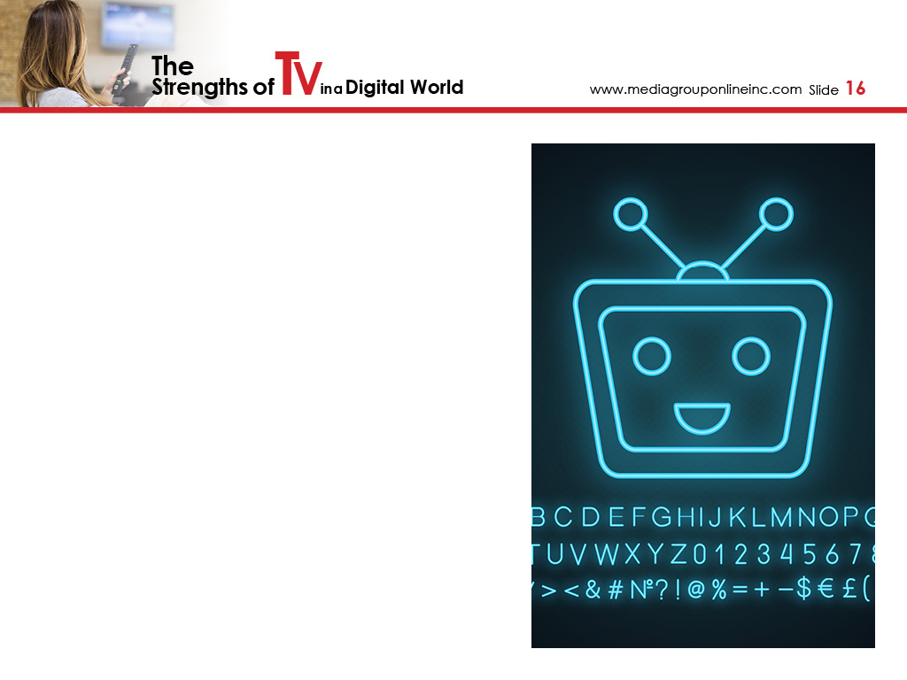
Artificial Intelligence IS Coming to TVs in Every Home
A November 2018 TV Technology article described Intel’s Neural Compute Stick 2 as “a full capacity artificial intelligence and vision processing device in a USB stick.” Plus, it only costs $99.
How the stick may affect TV viewing is a bit scary, but the article’s author states a TV could know who is watching the TV and recommend programs to watch based on viewers’ body language.
The point of all these (and many other technological advancements) is that the TV medium will only become stronger for content creators, broadcasters, local stations and advertisers – and create many exciting new opportunities for everyone.

